Slide 1

RENOVATION OF UNIVERSITY WEBSITE
PANCHANAN TURUK(15/04/DCS/04)
NAGMA BEGUM(15/04/DCS/03)
SRIDHAR SWAIN(15/04/DCS/08)
SIBANI PANIGRAHY(15/04/DCS/07)

Slide 2
OBJECTIVE
Make the existing website more user friendly
Introduce the feature of login and register
Finding all the information about admission more easily
Making the use of Asp. Net tools to develop website.
Improve the quality of the project
Modernisation using social media links.

Slide 3
EXISTING SYSTEM
Difficult for students.
Time consuming.
User Login and registration are not provided
All the facilities details are not given
No social media feature included.

Slide 4
PROPOSED SYSTEM
Provides online help for admission procedure and counselling.
Helps all the users to view the list of administrative staff.
Provides all the facilities available in the University.
Login users can take the advantage of the online registration
The User can follow the website on social media
User friendly

Slide 5
SYSTEM SPECIFICATIONS
1. Minimum Hardware Requirements
CPU : Intel Pentium
Operating system: windows/2003 or Linux
SPEED : 1 GHz
COPROCESSOR : BUILT IN
TOTAL RAM : 512 MB
HARD DISK : 50 GB
DISPLAY : SGVA COLOR
2. Software Requirements
FRONT END : HTML, CSS, JAVASCRIPT
BACK END : SQL Server, C#
OPERATING SYSTEM : WINDOWS 7/8/8.1/10
Server Deployment: IIS Server
IDE: VB.NET

Slide 6
CONTEXT DIAGRAM

Slide 7
DATA FLOW DIAGRAM

Slide 8
FLOWCHART

Slide 9
ER DIAGRAM

Slide 10
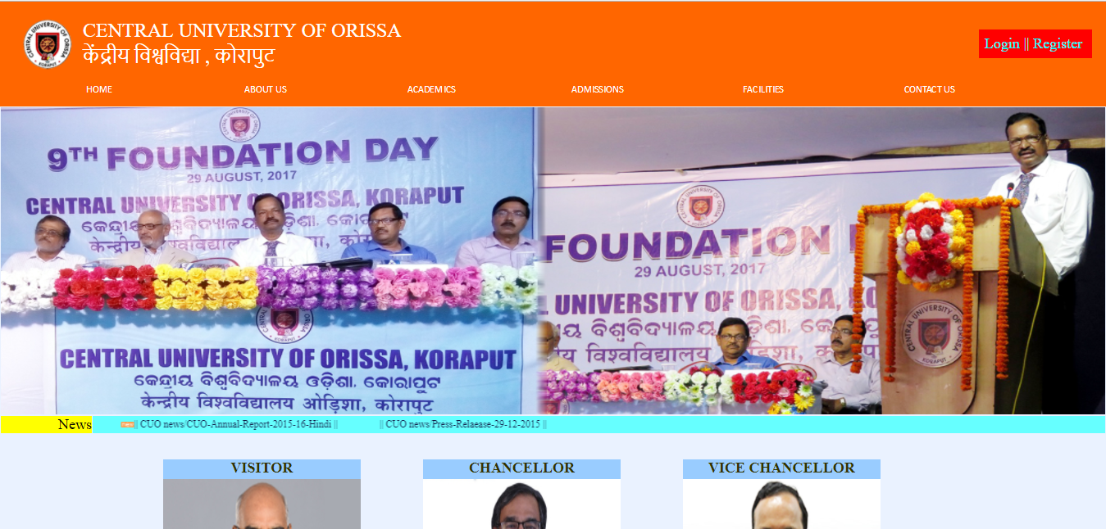
HOME PAGE

Slide 11
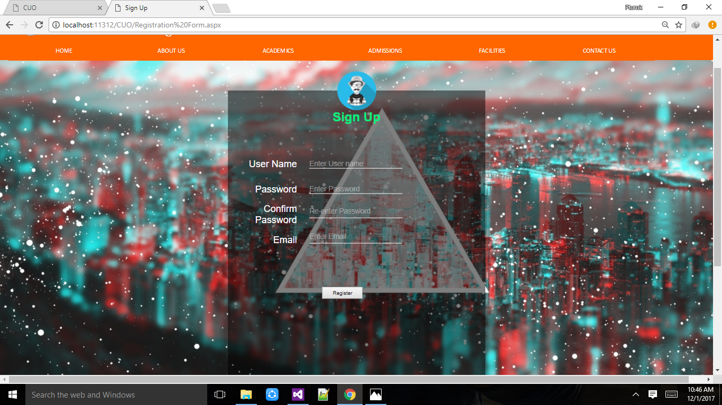
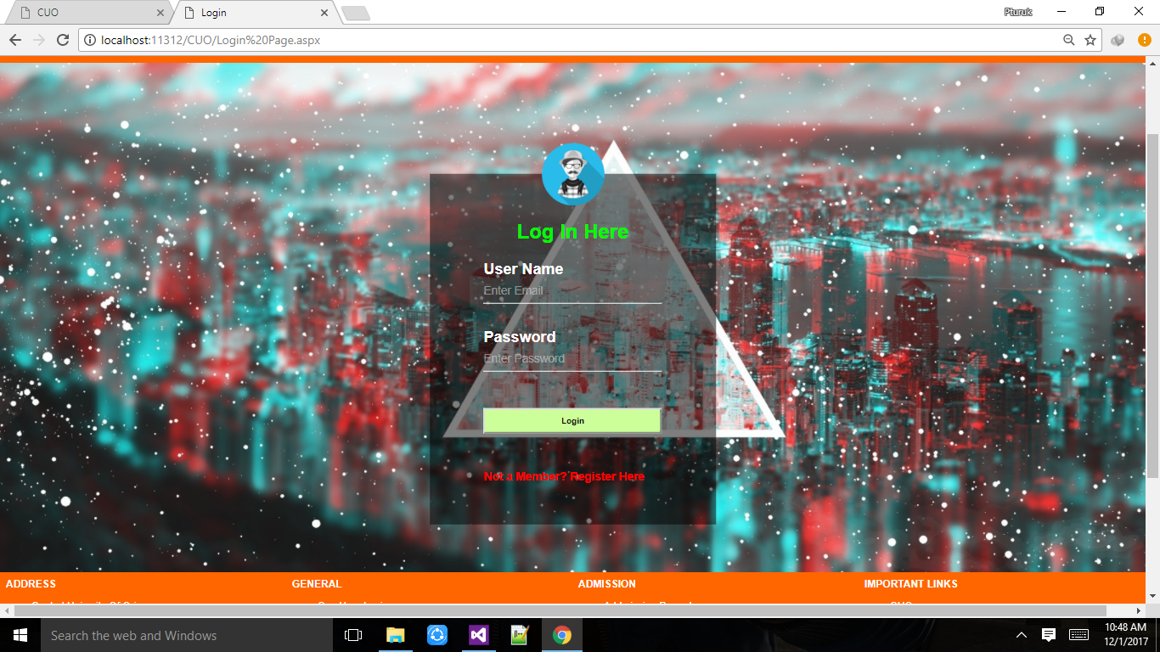
SIGN-UP PAGE LOGIN PAGE

Slide 12
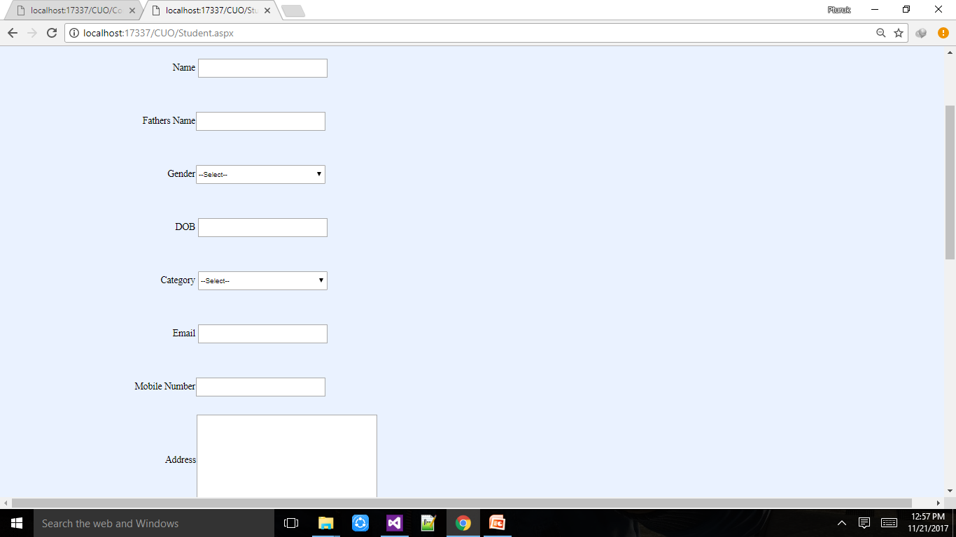
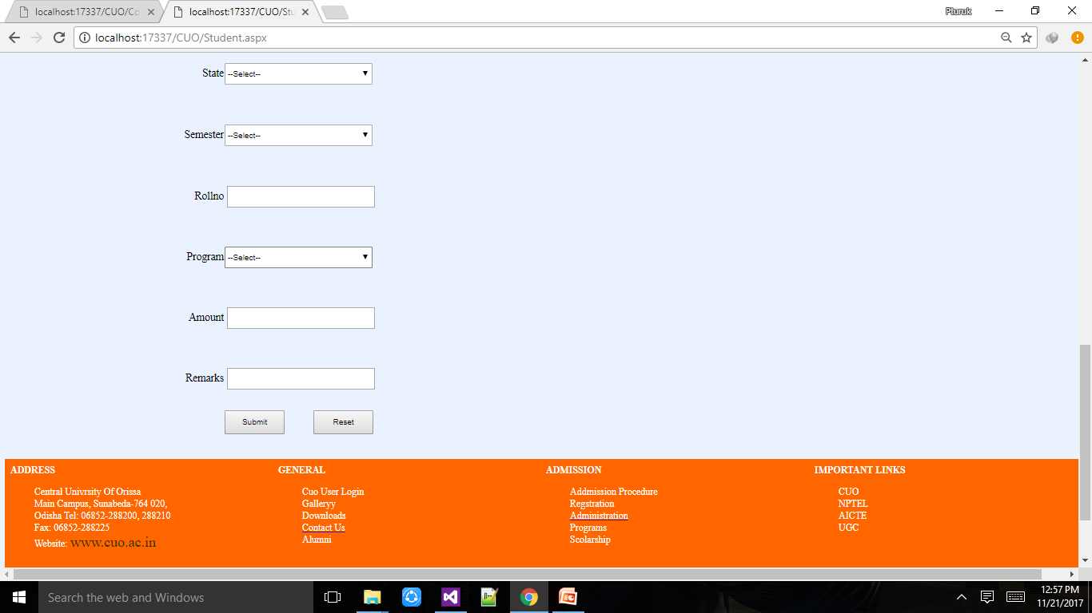
REGISTRATION FORM

Slide 13
CONCLUSION
The website central university of Orissa is completed, satisfying the required design specification.
The system provides a user-friendly interface.
This website is developed with modular approach.
All modules in the project have been tested the project have been tested the project have been tested with valid data and invalid data and everything works successfully.
The constraints are met and overcome successfully.

Slide 14
REFRENCES
W3 SCHOOLS ONLINE WEB TUTORIAL
Web Technology Black Book
Tutorial point
Professional vb.net Book by Billy Hollis and Fred Barwell
Programing Knowledge (https://www.youtube.com/user/ProgrammingKnowledge)
Kudvenkat (https://www.youtube.com/channel/UCCTVrRB5KpIiK6V2GGVsR1Q)
ASP.NET Tutorials (https://docs.microsoft.com/en-us/aspnet/tutorials)
Online Tutorial (https://www.youtube.com/channel/UCbwXnUipZsLfUckBPsC7Jog

